Slide 1
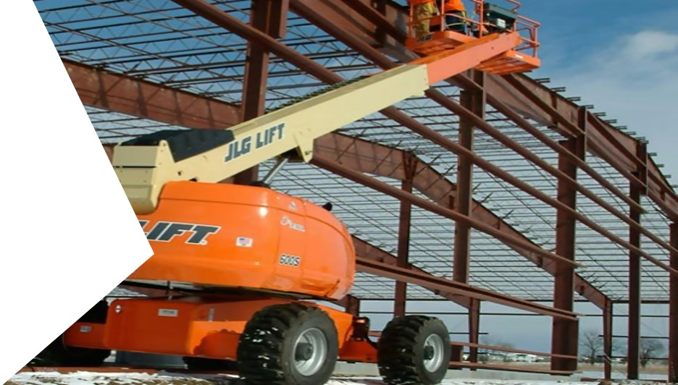
Aerial Lifts in Construction

Slide 2
Disclaimer
Aerial lifts for Construction
This material was produced under
grant number SH-05073-SH8 from
the Occupational Safety and Health Administration, U.S. Department of Labor.
It does not necessarily reflect the views or policies of the U.S. Department of Labor, nor does mention of trade names, commercial products, or organizations imply endorsement by the U.S. Government.

Slide 3
Welcome
Aerial lifts for Construction
Types of Lifts
Care / Inspections
Safe Operation

Slide 4
Module-1
Aerial lifts for Construction
Types of Lifts
Care / Inspections
Safe Operation

Slide 5
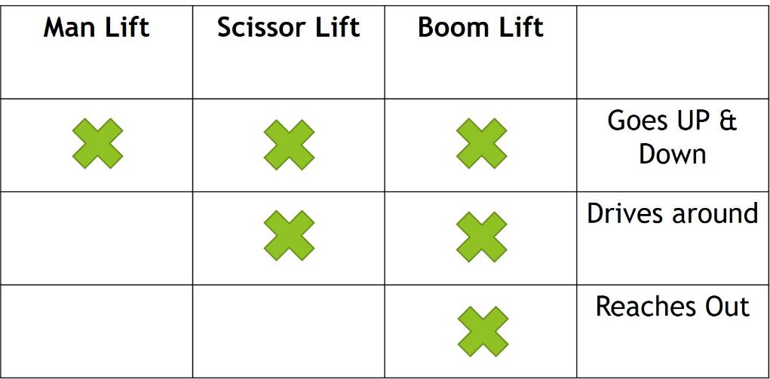
Aerial lifts for Construction - Types
Aerial lifts for Construction

Slide 6
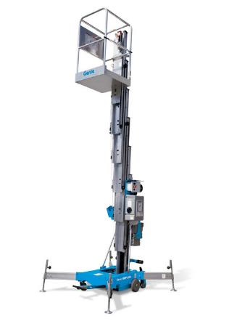
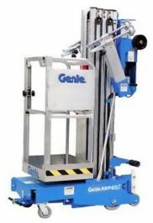
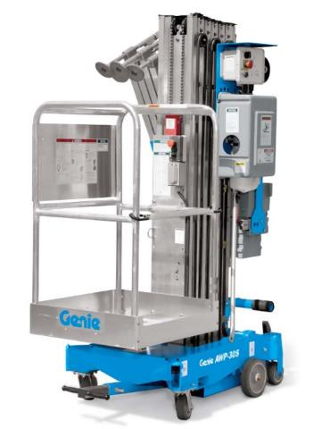
Aerial lifts for Construction – Man Lifts
Aerial lifts for Construction
Man Lifts

Slide 7
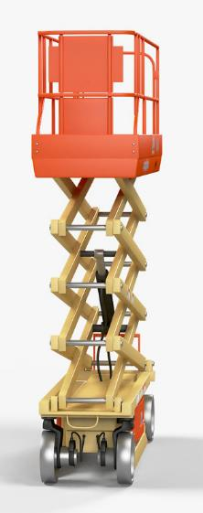
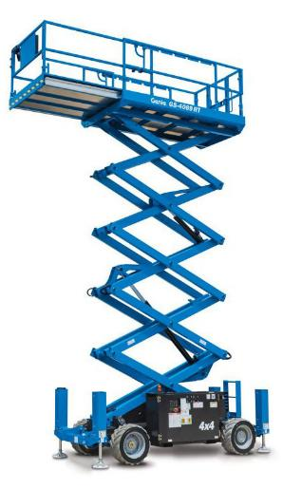
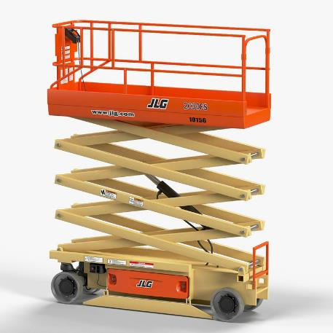
Aerial lifts for Construction – Scissor Lifts
Aerial lifts for Construction
Scissor Lifts

Slide 8
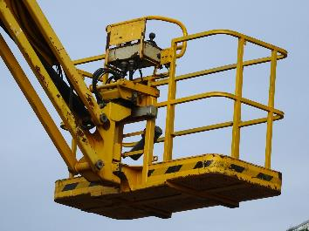
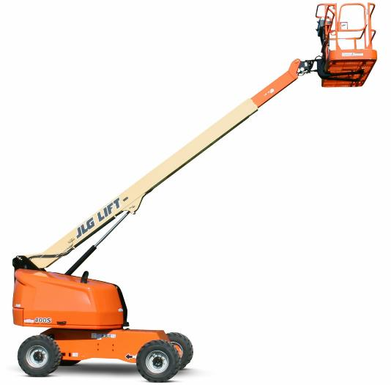
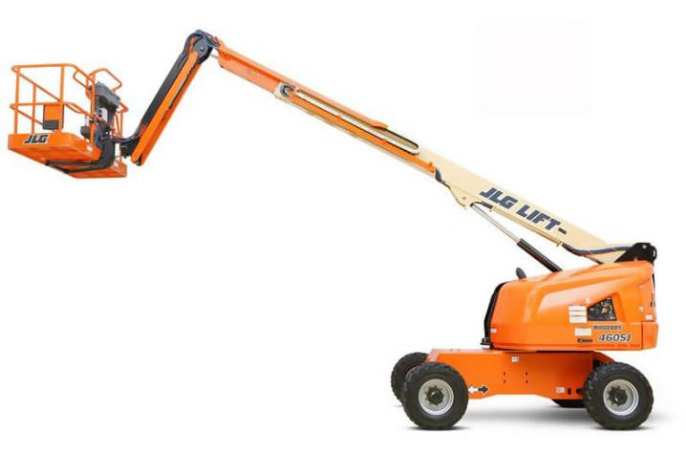
Aerial lifts for Construction – Boom Lifts
Aerial lifts for Construction
Boom Lifts

Slide 9
Selection of Aerial lifts for Construction
Aerial lifts for Construction
Selection
When deciding which Aerial Lift to choose for your specific job, the height and the reach requirements, outdoor or indoor working environments, and the weight capacity you’ll need for your particular job will tell you which type of equipment you need.
You will need to train your employees on how to operate specific types of aerial lifts properly and safely.

Slide 10
Module-2
Aerial lifts for Construction
Types of Lifts
Care / Inspections
Safe Operation

Slide 11
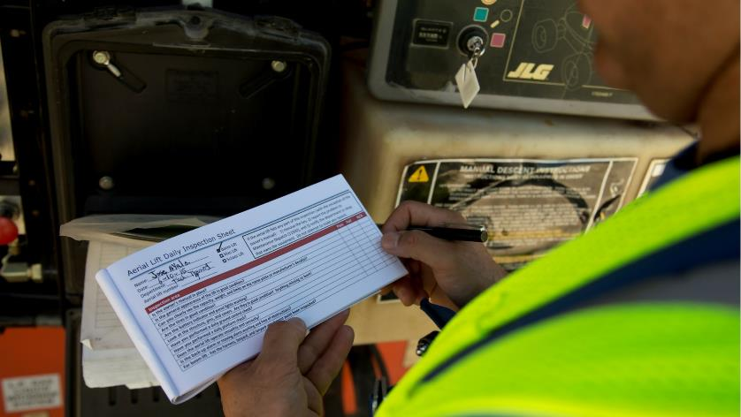
Care & Inspections
Aerial lifts for Construction
Care & Inspections
ALWAYS Follow the Manufacturer's Instructions for operations.
Located in the compartment you should also find a list of items to be inspected.

Slide 12
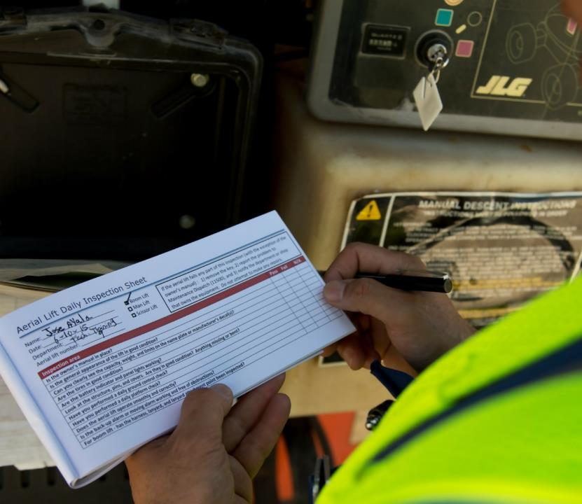
Pre-start Inspection
Aerial lifts for Construction
Pre-start Inspection
Prior to each work shift, conduct a pre-start inspection to verify that the equipment and all its components are in safe operating condition. Follow the manufacturer's recommendations and include a check of:
Operating and Emergency Controls
The Boom
Guardrails
Hydraulic System
Outriggers
Emergency Stop Buttons
Tires
Safety Guards and Sensors
Emergency Descent System

Slide 13
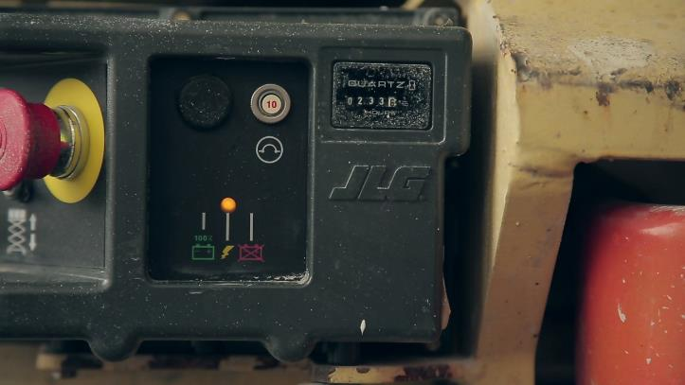
Pre-start Inspection – Part 2
Aerial lifts for Construction
Ensure that the lift is always FULLY CHARGED before each use.
Do you drain the batteries? Nothing ruins batteries more than running them dead..
Approximately 50% of premature battery failures is caused by the loss of water for normal recharging charging due to the lack of maintenance, evaporation from high under hood heat,

Slide 14
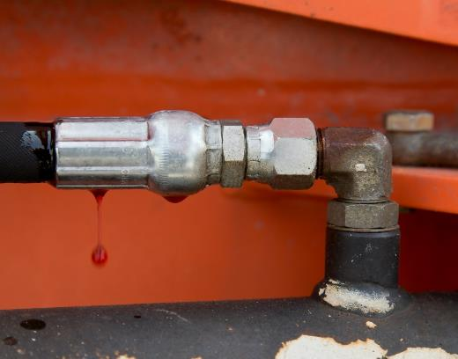
Pre-start Inspection – Part 3
Aerial lifts for Construction
Inspect for Hydraulic oil leaks.
DO assess a leak as soon as it is noticeable.
A minor leak could be a sign of a more severe problem within your hydraulic system. Resolving the issue as soon as possible can help prevent further performance issues and inefficiencies.
Time is of the essence regarding hydraulic leaks!

Slide 15
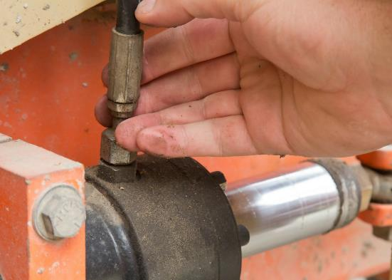
Pre-start Inspection – Part 4
Aerial lifts for Construction
CAUTION!
DON’T ever use your hand to check for a hydraulic leak!
Hydraulic fluid can reach temperatures of 300 degrees Fahrenheit or higher which would result in a severe burn if it were to ever meet your skin.
These leaks can have a velocity of more than 600 feet per second and have been known to inject fluid through the skin, including that which is covered with thick leather gloves. Burns such as these would require immediate medical attention, possible amputation

Slide 16
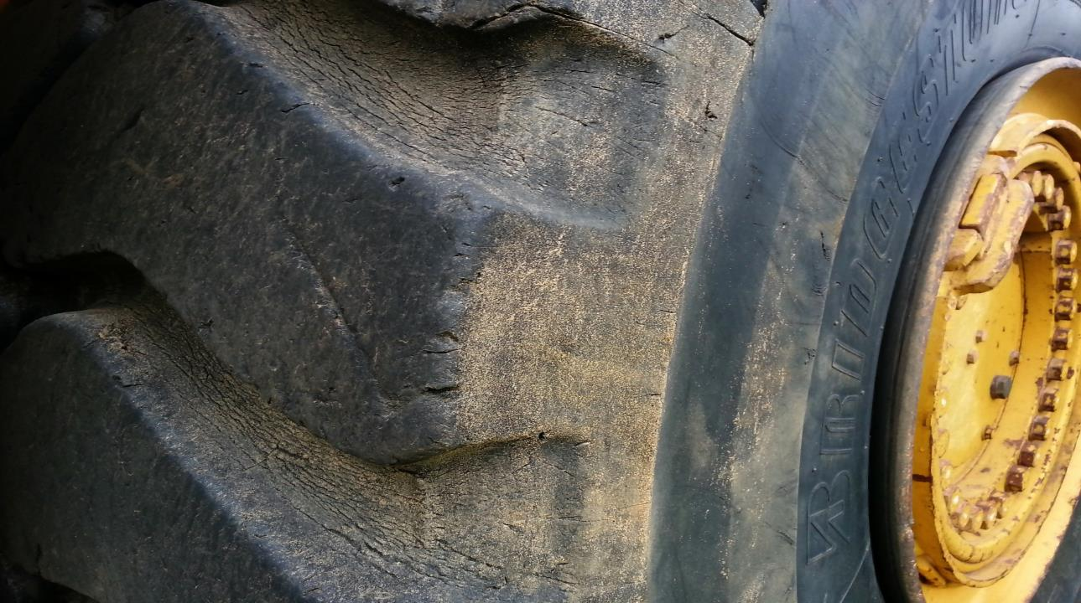
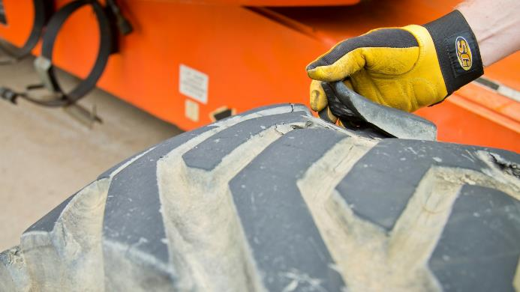
Pre-start Inspection – Part 5
Aerial lifts for Construction
You should routinely inspect all tires for
Cuts, tears, or missing chunks to the tread area and sidewalls. Additionally, solid rubber tires should be frequently checked to ensure they are completely bonded to the rim.

Slide 17
Module-3
Aerial lifts for Construction
Types of Lifts
Care / Inspections
Safe Operation

Slide 18
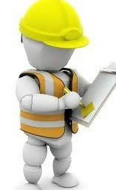
Safe Operation
Aerial lifts for Construction
Start with a Worksite inspection
It is necessary to inspect the work site also. Items to inspect include:
The surface on which the lift will be used,
Hazards that might create dangerous driving conditions,
Above hazards that may effect personal while the lift is extended,
Weather conditions
(Additional inspections may be required by the lift manufacturer.)

Slide 19
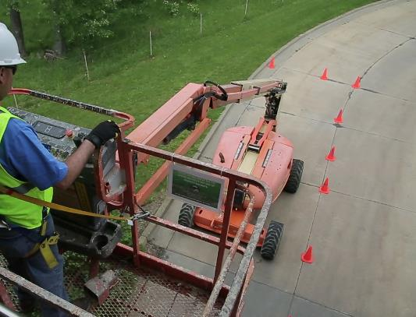
Safe Operation - Part 2
Aerial lifts for Construction
Failure to cordon off:
• Aerial lifts have been struck by other
construction equipment or oncoming traffic when the work
area is not properly marked or cordoned off.
• Workers can be injured if they inadvertently
enter an unmarked area and are struck by falling
material, tools, or debris.
• In unmarked areas, workers can be injured
by swinging booms and pinched by scissor
mechanisms

Slide 20
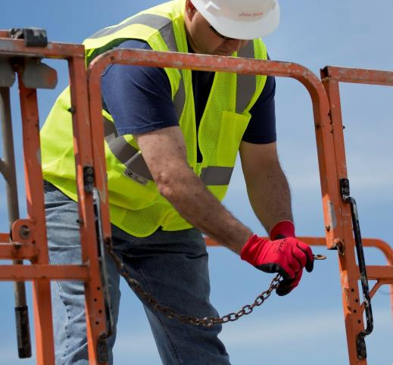
Safe Operation – Part 3
Aerial lifts for Construction
Make sure that you have received proper training (both general training and hands-on practical training)
Thoroughly read the operator’s manual and safety signs on the machine, and understand the function and location of all safety devices and controls before beginning operation.
Fatalities caused by falls from elevation continue to be a leading cause of death for construction workers. Please ensure that platform gates close and or chains are attached.

Slide 21
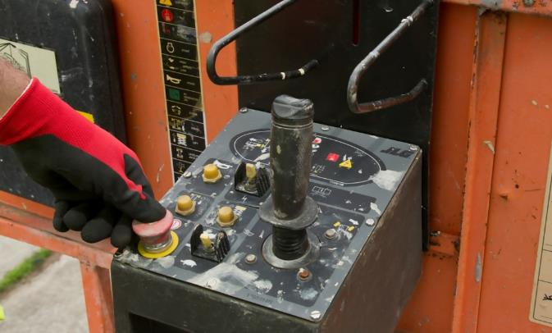
Safe Operation – Part 4
Aerial lifts for Construction
When you have reached your work area, Push the Emergency Stop Button, to be sure the lift does not move.
Pushing in the Red Emergency Stop button to the off position will stop all functions and turns the engine off.
Pull out the red Emergency Stop button to the on position to run the machine again.

Slide 22
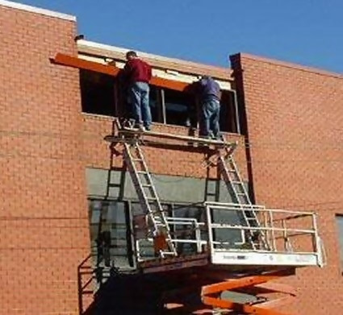
Safe Operation – Part 5
Aerial lifts for Construction
Always watch out for pedestrian.
Be sure to beep horn and clearly communicate your moves.
Never allow anyone to climb the sides of lift.
Ladders must NEVER be used on the platform. Just one step on the ladder, makes the guard rails lower and ineffective.

Slide 23
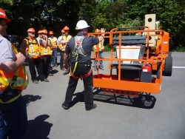
Safe Operation – Part 6
Trained and
Authorized Operators
Aerial lifts for Construction
Only operate Aerial Lifts if trained and Authorized
Understand Operating Instructions and Safety rules.
Receive Hands-on Training from a Qualified Person.
Know how to Inspect Equipment and Work Area.
Demonstrate How to Safely Operate Equipment.
Keep at Least 10 feet Away from Power Lines.
Never disable a safety or warning device.

Slide 24
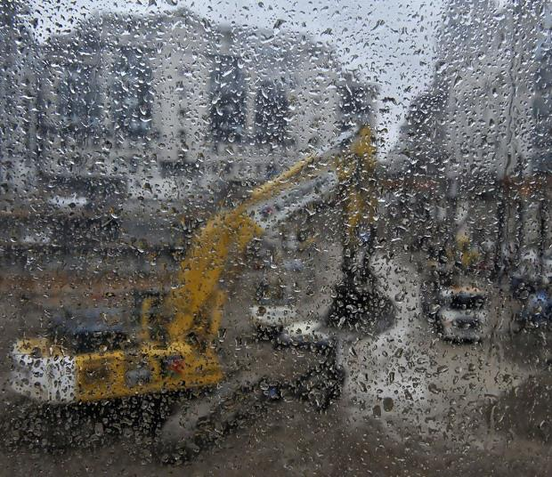
Safe Operation – Part 7
Aerial lifts for Construction
Use the Aerial lift outside only when weather conditions are good.
Scissor lifts rated for outdoor use are generally limited to wind speeds below 28 miles per hour.

Slide 25
Safe Operation – Part 8
Aerial lifts for Construction
Weather Factors and Aerial Work Platforms
Weather conditions can adversely affect Aerial Work Platform lifting activities. They need to be thoroughly considered both during the planning and execution of a Boom lift or Scissor Lift. Special efforts may be required to ensure adequate warning is provided to avoid a sudden storm disrupting a lift in progress.
WIND
Note: In the absence of manufacturers’ specific written advice, seriously consider postponing use of the lift if the wind speed/gust is in the range of 15-28 mph. Above 28 mph use of the lift must be canceled.

Slide 26
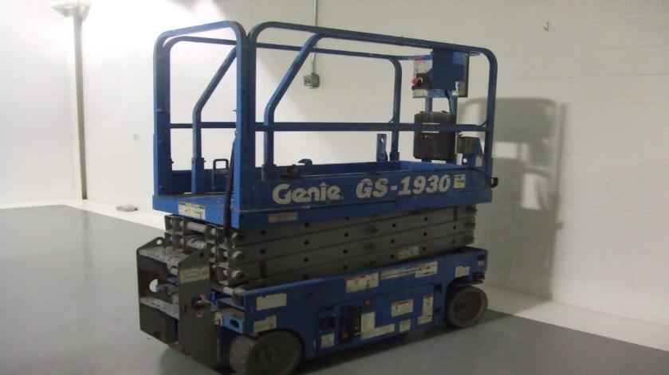
Safe Operation – Part 9
Is Fall Protection Needed?

Slide 27
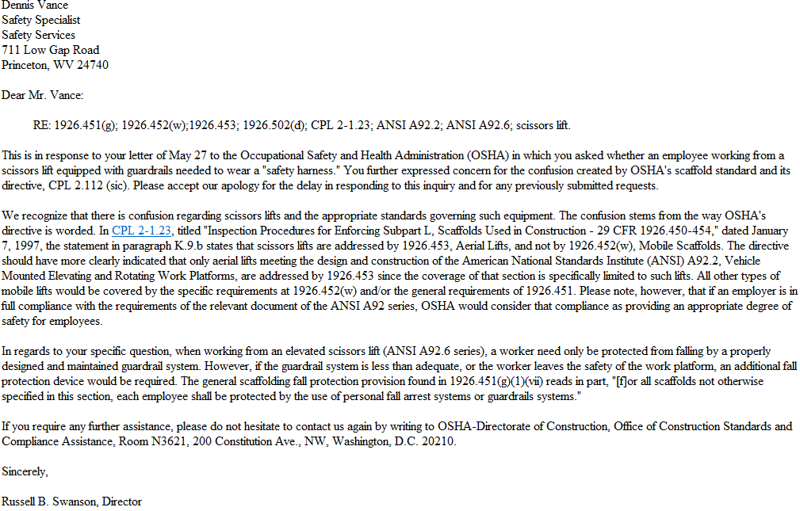
Safe Operation – Part 10
Aerial lifts for Construction

Slide 28
Safe Operation – Part 11
Aerial lifts for Construction
In almost every industry, there are areas where workers are subjected to fall hazards.
When selecting fall protection equipment, three components make up a complete fall protection system. These are the ABC’s of fall protection:
Anchorage... Body support… Means of Connection
Each one must be in place and properly used to provide maximum worker protection.
The connecting device is the most critical link in assembling a safe fall protection system since it bears the greatest force during a fall.
Notes:
Careful consideration must be given to the selection, materials, construction and inspection/maintenance of fall Protection equipment

Slide 29
Fall Protection
Aerial lifts for Construction
OSHA Standard 1926.503(a)(1)
The employer shall provide a training program for each employee who might
be exposed to fall hazards.
The program shall enable each employee to recognize the hazards of falling and shall train each employee in the procedures to minimize these hazards.

Slide 30
HIERARCHY OF FALL PROTECTION
HIERARCHY OF FALL PROTECTION
Elimination or Substitution
Most Effective
Passive Fall Protection
Active Fall Restraint System
Active Fall Arrest System
Administrative Controls
Least Effective
Notes:
Hierarchy of Fall Protection: A series of fall protection solutions ranging from the best solution to the worst.
Eliminate the Fall Hazard (Most Effective)
Passive Fall Restraint
Active Fall Restraint
Active Fall Arrest
Administrative Controls (Least Effective)

Slide 31

Personal Fall Arrest Systems (PFAS)
Aerial lifts for Construction
Personal Fall Arrest Systems (PFAS)
A PFAS consists of the following components:
Anchorage Point
Body Harness
Connector

Slide 32
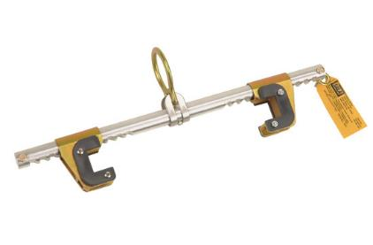
Personal Fall Arrest Systems (PFAS) – Part 2
Aerial lifts for Construction
Personal Fall Arrest Systems (PFAS)
A PFAS consists of the following components:
Anchorage Point
Body Harness
Connector
1926.502(d)(15)
Anchorages used for attachment of personal fall arrest equipment shall be independent of any anchorage being used to support or suspend platforms and capable of supporting at least 5,000 pounds (22.2 kN) per employee attached.

Slide 33
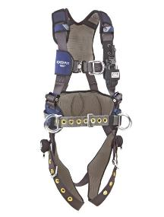
Personal Fall Arrest Systems (PFAS) – Part 3
Aerial lifts for Construction
Personal Fall Arrest Systems (PFAS)
A PFAS consists of the following components:
Anchorage Point
Body Harness
Connector
OSHA defines a Body Harness as:
“… straps which may be secured about the employee in a manner that will distribute the fall arrest forces over at least the thighs, pelvis, waist, chest and shoulders with means for attaching it to other components of a personal fall arrest system”

Slide 34
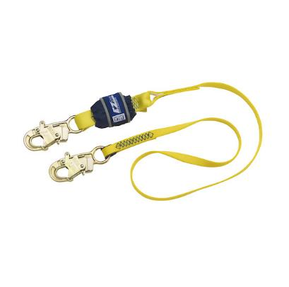
Personal Fall Arrest Systems (PFAS) – Part 4
Aerial lifts for Construction
Personal Fall Arrest Systems (PFAS)
A PFAS consists of the following components:
Anchorage Point
Body Harness
Connector
Connector
The connecting subsystem is the critical link which joins the body wear to the anchorage/anchorage connector. It can be an energy-absorbing lanyard, fall limiter, self-retracting lanyard, rope grab, or retrieval system. Connecting means will vary depending on whether the worker is equipped for personal fall arrest or work positioning and travel restriction

Slide 35

Review
Aerial lifts for Construction

Slide 36
Knowledge Check
What are the three basic types of lifts used in Construction?

Slide 37
Knowledge Check – Part 2
What are the three basic types of lifts used in Construction?
Man Lifts
Scissor lifts
Boom Lifts (articulating lifts)

Slide 38
Knowledge Check – Part 3
A Pre-Start inspection should include….

Slide 39
Knowledge Check – Part 4
A Pre-Start inspection should include….
Operating and Emergency Controls
Guardrails
Hydraulic System
Outriggers
Emergency Stop Buttons
Tires
Safety Guards and Sensors
Emergency Descent System

Slide 40
Knowledge Check – Part 5
3. When inspecting the work site, you must also look for what?

Slide 41
Knowledge Check – Part 6
3. When inspecting the work site, you must also look for what?
The surface on which the lift will be used.
Hazards that might create dangerous driving conditions.
Above hazards that may effect personal while the lift is extended.
Weather conditions.

Slide 42
Knowledge Check – Part 7
4. Is fall protection needed in a scissor lift?

Slide 43
Knowledge Check – Part 8
4. Is fall protection needed in a scissor lift?
When working at heights, employees need to be protected from falling.
On a scissor lift, a fall protection harness is not required, provided that the guardrails on the scissor lift meet the requirements of the fall protection standard.

Slide 44
Additional Resources
OSHA website: http://www.osha.gov and OSHA offices: Call or Write (800-321-OSHA)
Compliance Assistance Specialists in the area offices
National Institute for Occupational Safety and Health (NIOSH) – OSHA’s sister agency
OSHA Training Institute Education Centers
Standards that Apply OSHA Standards: 29 CFR 1910.67, 29 CFR 1910.269(p), 29 CFR 1926.21, 29 CFR 1926.453, 29 CFR 1926.502. American National Standards Institutes standards: ANSI/SIA A92.2-1969, ANSI/SIA A92.3, ANSI/SIA A92.5, ANSI/SIA A92.6.

